Slide 1
Identify and recommend the issue product
through the real-time ranking crawling
-서문456-
최승진, 이진호, 김은경

Slide 2


001/ Team role
최승진
Data Crawling
MongoDB
이진호
Data Crawling
CF Algorithm
김은경
Data Crawling
Web page

Slide 3
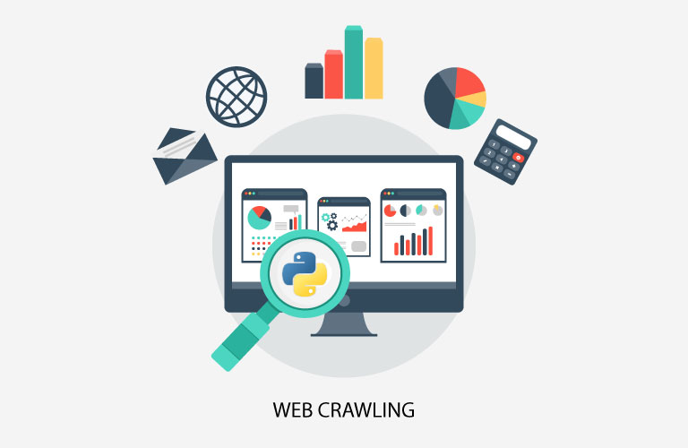
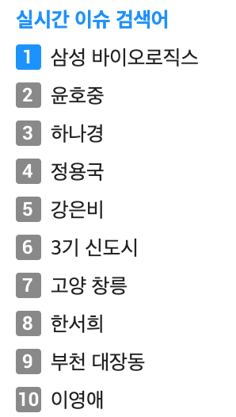
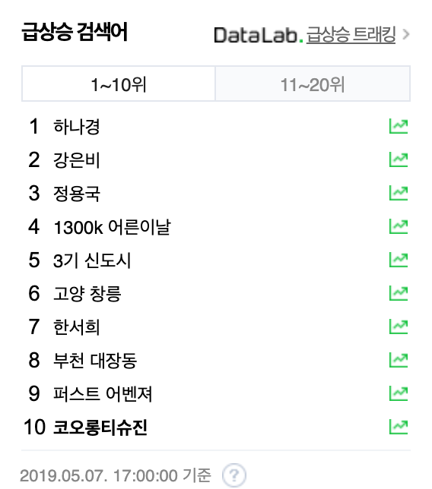
002/ Project subject
✓ Collect portal site issue data using data crawling
✓ Check whether the data collected and the data of the mart product are matched
✓ Increase the matching item rating weight
✓ Visualization of recommendation list

Slide 4
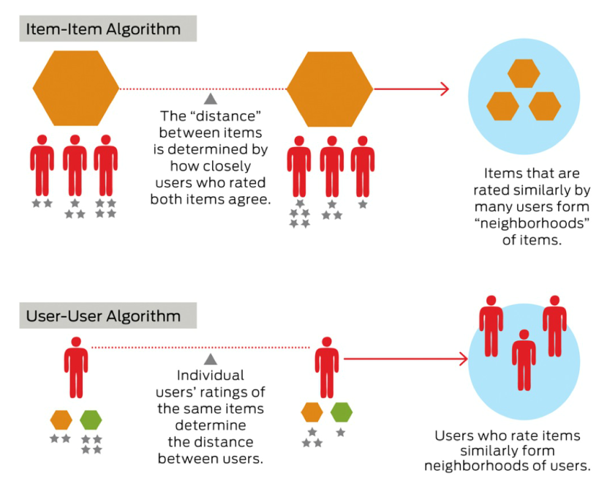
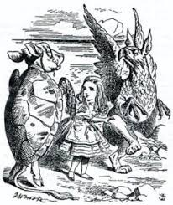
003/ Development plan
Data storage
Recommendation System
External DB
Mongo DB
Naver
Daum
Google trend
Check whether the ranking of real-time search word and the mart product are matched
Beautiful Soup
Apply the ranking of matched search word to recommendation system (rating up)

Slide 5
003/ Development plan
Project plan | ~5/9 | ~5/16 | ~5/23 | ~5/30 | ~6/6 | ~6/13
Web crawling
Visualization
Web page
presentation

